Slide 1

Class 2 -2018
November 2018
Trap vs Free Cycle

Slide 2
Free Man
Unbalanced
Intervention
Return to Free Man

Slide 3
Free Man:
Balanced, man trades fair work for fair money for his needs (food shelter etc.)
and he keeps a balance of needs with income
from his work.
Does not buy above his means.

Slide 4
Unbalanced / Enslaved imposed by self or others:
Fair work will not generate enough money for his needs.
Needs, like Food Shelter outweigh income to cover needs. Going into a hole.

Slide 5
Intervention:
Someone or an organization steps in to help to break the trap cycle and keep it balanced.
Done through actions, self-discipline, contracts and laws .

Slide 6
PAST
A look at the past as a history of labor problems, way back:
Let look at a early Trap to Free cycle
The Bible as a history lesson:
Joseph convinced his family to come back to Egypt and live there.
Joseph's family lived like kings as long as Joseph lived.

Slide 7
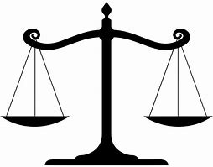
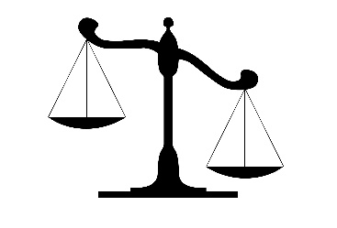
Free Man: Balance trades fair work works for fair money for needs (food, shelter and etc.)
Unbalance / Enslaved:
When Joseph died, and the Pharaohs forgot about him,
No contracts
Because of the times the bitterness of what had happened under him ( Pharaoh) came due.
And thus, the Hebrews were enslaved.
Unable to leave.
Unable to help themselves.

Slide 8
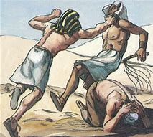
Intervention: Someone or an organization steps in to help to break the trap cycle and keep it balanced. Through actions, self-discipline, contracts and laws.

Slide 9
Invention
Many years later, when Moses had grown up, he went out to visit his people, the Israelites, and he saw how hard they were forced to work. During his visit, he saw an Egyptian beating one of the Hebrew slaves.
After looking around to make sure no one was watching, Moses killed the Egyptian and buried him in the sand.
The next day, as Moses was out visiting his people again, he saw two Hebrew men fighting. "What are you doing, hitting your neighbor like that?" Moses said to the one in the wrong. They told him that he Moses killed a man.

Slide 10
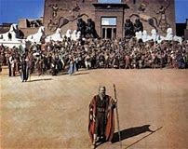
He came back and changed the course of history by standing up for the Slaves.
Thus returning to
Free Man: Balanced man trades fair work for fair money for his needs (food shelter etc.)
and he keeps a balance of needs with income from work.
Ref: Jonathan Orr-Stav, Hebrew-English translator & editor
Exodus chapter 1 (TEV), Exodus chapter 2 (NLT)

Slide 11
Trap vs Free Cycle 1900 to 1950
Unbalance / Enslaved:
Company Scrip: A Dark Chapter in American History
Remember this song?
“You load sixteen tons, what do you get
another day older and deeper in debt
Saint Peter don’t you call me ’cause I can’t go
I owe my soul to the company store”
‘Sixteen Tons’
Tennessee Ernie Ford

Slide 12
Sad but true this system went on!
“You will be paid in Company Script. Not cash and we will deduct your expenses when you get paid.”
It never balanced out the only who got ahead was the company.
The company owned the store
No other places to buy supplies
The company owned the tools you used
The doctor you saw worked for the company.

Slide 13
Although coal companies refused to exchange scrip with legal tender, some miners found other locals willing to purchase coal scrip for a fraction of its value about .30 on the dollar was average.
To combat this, a 1925 West Virginia law, driven by coal lobbyist, made it unlawful for scrip to be transferred to a third party. This law further solidified the company’s power over employees, effectively holding them hostage from escaping to other jobs or regions of the nation.
Within a generation, an entire workforce stood at the mercy of coal companies; which ultimately became the catalyst which drove miners to risk everything and join unions.
Intervention: Someone or an organization steps in to help to break the trap cycle and keep it balanced. Through actions, self-discipline and contracts.

Slide 14
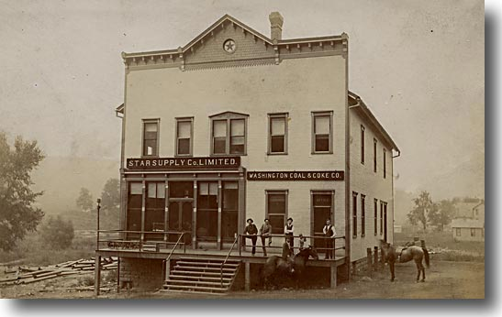
Company Store
Washington Coal & Coke Co.

Slide 15
How would you like to get paid Friday in Walmart bucks that could only be exchanged at Walmart?
But Tuesday they raised the prices 20%.
Where you going to go?
You only have scrip that only the Walmart store.
We are not picking on Walmart used for example only.

Slide 16
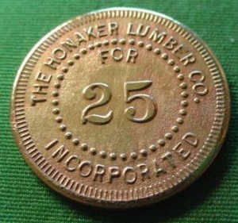
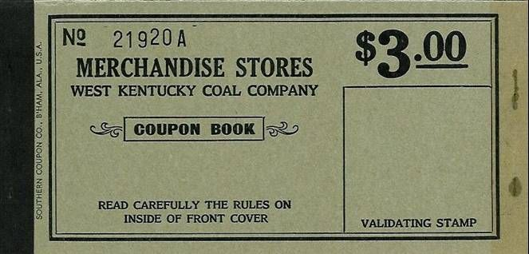
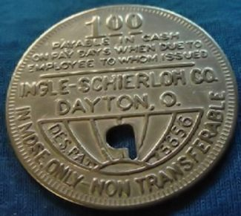
Company script

Slide 17
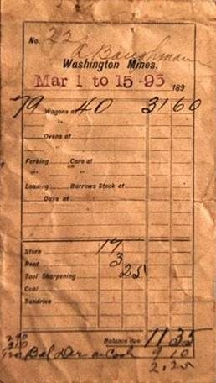
Here is an actual pay envelope for a miner by the name of A. Baughman. The pay period was March 1 to 15, 1895.

Slide 18
Mr. Baughman loaded 79 cars, each of which was 5 tons of coal.
He was paid 40 cents per car for a total of $31.60.
$31.60 Pay earned
-17.00 store bill
- 3.00 rent for home
- .25 tool sharpening
- 9.10 Company Doctor
$2.25 Balance due
            paid in Scrip.
Do you think if needs more money to live on he will go to the Company Store and put it on credit?
He will have to go deeper in debt as the song said.

Slide 19
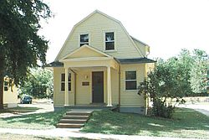
In all fairness there were Companies where tried to make life better for workers ran a good system of housing and stores.
Like Jaite Paper Mills in Brecksville, Ohio
Jaite Mill Historic District in the Brecksville, Ohio
10 miles west of Cleveland, Ohio
Company towns for the most part were not a place that was good for workers and their family. Although there were places like Jaite Paper Mill towns but far and few between.

Slide 20
Present
How do strikes work.
Last thing we want is a strike.
But is some times it must happen.
When you vote to give the right for the Union reps to strike you are not telling them to strike but giving them the power to do so much like giving a police officer authority to arrest someone but not telling them to do so. .
There is a set procedure to go down that path if it comes to that.
It has been written and time tested.

Slide 21
Future
Have a plan incase you need it.
We do have one!

Slide 22
UAW STRIKE
ASSISTANCE
DEPARTMENT

