Slide 1

UAW STRIKE
ASSISTANCE
DEPARTMENT
Secretary–Treasurer
Gary Casteel
Blake Miller - Assistant Director

Slide 2
HISTORY OF UAW STRIKE FUND
Founded 1935
Needed Additional Funds to Gain Benefits in Negotiations
Added Holiday Bonuses
Increase Strike Benefits to $200
Extra ½ hour in dues exclusively for Strike & Defense Fund

Slide 3

UAW Constitution
Article 12, Section 14
Article 16, Section 8
Article 16, Section 21
Administrative Letter
  Volume 49, Letter #1

Slide 4
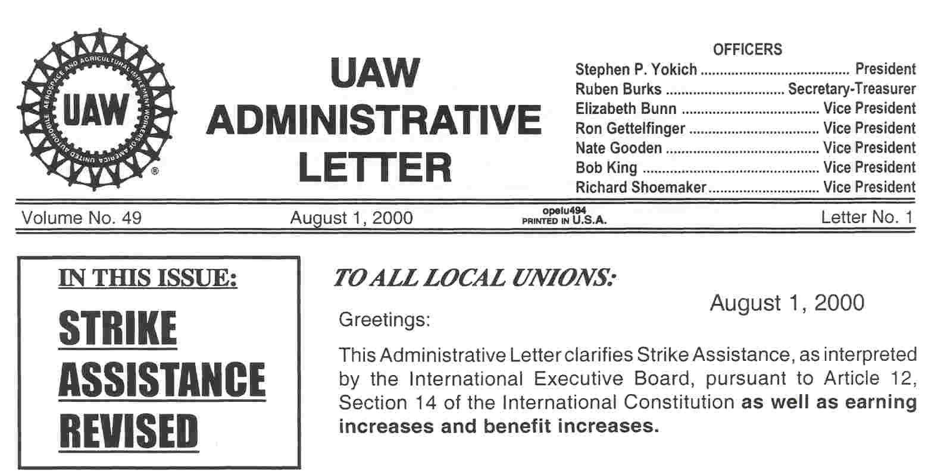

Slide 5
ELIGIBILITY FOR STRIKE ASSISTANCE
Must be a member in Good Standing per
  UAW Constitution
Article 16, Section 5 and 21 – Initiation Fees and Dues
2. Must be on ACTIVE PAYROLL at start of strike;
members laid-off, are on workers compensation,
or receiving sick & accident are not eligible.
3. Must Participate:
Picket Assignments
Strike Committee
Pick Up Strike Benefit Check On Assigned Day

Slide 6
ELIGIBILITY FOR STRIKE ASSISTANCE
If a member gets another job can they
receive strike assistance?
  They must continue to participate in strike and if:
  -Gross pay is less than $200 then
  Yes – weekly benefits
  Yes – medical assistance
  -Gross pay is equal to or greater than $200 then
  No – weekly benefits
  Yes – medical assistance

Slide 7
SCHEDULE OF BENEFITS
Eligible for weekly benefits after the 7th day
Strike assistance is made available after the 15th day
Weekly benefits are $200 per week
($40 per day, Mon–Fri, beginning on the 8th day)
Members MUST pick up own benefit on the assigned
day and time
Back to work check

Slide 8
HOLIDAY BONUS
A bonus check is paid the
week prior to the
Thanksgiving & Christmas holidays.
TAX INFORMATION
Weekly strike benefits are taxable.
$600 plus in a given year
IRS Form 1099-MISC will be issued

Slide 9
ADDITIONAL BENEFITS
Basic Group Life Insurance
Transition Bridge ~ for surviving spouse
(contract must have TB in the Language)
Medical Assistance
  Doctor
  Hospital
  Prescriptions
  COBRA Option

Slide 10
EXCLUDED BENEFITS
Dental
Vision
Audio
Sick & Accident

Slide 11
ADMINISTRATION OF MEDICAL ASSISTANCE
Third Party Administrator – AmeraPlan Inc.
The Strike Fund directly pays medical benefits
according to the current company plan.
- OR -
Members remain on the company plan (COBRA).
The strike fund will reimburse members who pay
their cobra premiums.

Slide 12
COBRA
Company must offer medical insurance
COBRA letters
Important dates:
14 days to notify
60 days to apply
45 days to mail premium
Members MUST bring COBRA papers

Slide 13
PREPARATIONS BEFORE THE
STRIKE

Slide 14
August 20XX
Sunday | Monday | Tuesday | Wednesday | Thursday | Friday | Saturday
 |  |  | 1 | 2 | 3 | 4
5 | 6 | 7 | 8 | 9 | 10 | 11
12 | 13 | 14 | 15 | 16 | 17 | 18
19 | 20 | 21 | 22 | 23 | 24 | 25
26 | 27 | 28 | 29 | 30 | 31 | 1 Sept.
Update Membership List
Active, Laid Off, Sick Leave, Workers Compensation
Be sure membership is up to date on LUIS
Contact your software provider
Excel format
Back up membership file to a thumb drive

Slide 15
EXCEL FORMAT
Social Security Number – all digits NO dashes
ALL TEXT FIELDS ARE CAPITALIZED

Slide 16
August 20XX
Sunday | Monday | Tuesday | Wednesday | Thursday | Friday | Saturday
 |  |  | 1 | 2 | 3 | 4
5 | 6 | 7 | 8 | 9 | 10 | 11
12 | 13 | 14 | 15 | 16 | 17 | 18
19 | 20 | 21 | 22 | 23 | 24 | 25
26 | 27 | 28 | 29 | 30 | 31 | 1 Sept.
Obtain copies of: Medical Insurance Plans,
Schedule of Benefits, Life Insurance, Co-Pay Information
AmeraPlan: Will Administer Medical Assistance Based On These Plans
Life Insurance: Benefit amount
Co-Pays: Dr. Appointments, Rx (Generic and Brand Name)

Slide 17
August 20XX
Sunday | Monday | Tuesday | Wednesday | Thursday | Friday | Saturday
 |  |  | 1 | 2 | 3 | 4
5 | 6 | 7 | 8 | 9 | 10 | 11
12 | 13 | 14 | 15 | 16 | 17 | 18
19 | 20 | 21 | 22 | 23 | 24 | 25
26 | 27 | 28 | 29 | 30 | 31 | 1 Sept.
Assemble Your Strike Committee
Counselors, Picket Captains, Sargent-At-Arms, Strike Kitchen
Standing Committee Members
Counselors - register members and distribute benefit checks
Sargent-At-Arms - keeps order at the union hall
Strike Kitchen - coffee, donuts and food donations
Picket Captains - keep track of member’s picket assignments
Strike Committee - this is your strike assignment

Slide 18
SET UP ACCOUNTS FOR
STRIKE KITCHEN AND SUPPLIES
Pickets supplies
  (sticks for picket signs, office supplies,
  garbage cans, etc.)
Port-A-Johns (serviced weekly)
Bakery Account (for donuts)
Kitchen Supplies (coffee, sugar, cream,
    cups, plates, paper towels, etc.)

Slide 19
Strike Counselor’s Duties
at UNION HALL
Register Members
  Strike Benefits
  Medical Assistance
  Distribute Benefit Checks

Slide 20
Picket Captain’s Duties
Set Up Picket
    Location
    Times
    Build Picket Signs
  Keep Members Orderly and
  Courteous on the Picket Line
  Prepare Assignments
  for Members

Slide 21
Strike Kitchen Committee Duties
Set Up Kitchen
  Coffee and Coffee Pots
  Supplies
  Solicit Help From Area Merchants
  Make Arrangements To Get Coffee and Donuts to Members on Picket Duty

Slide 22
Sergeant-at-Arms Duties
  Keep order while benefits are being paid.
  Local Union Benefit Representatives
    Assist members with benefit
    questions and problems.

Slide 23
Community Services and
Education Committees
These committees will be mobilized to reach out to the community and set up education classes.

Slide 24

PREPARATION – UNION HALL
Capacity of your hall
Parking Lot - can it handle registration
  and weekly pay
Kitchen Needs:
  coffee pots
  refrigerator
  storage

Slide 25
UAW Local 2008 - Union Hall
Kitchen
Exit
Offices
Capacity ?
ABC MFG
East Road
Entrance
Exit
Parking Lot Size
Parking
South Road
South Road

Slide 26
Strike Notice

Slide 27
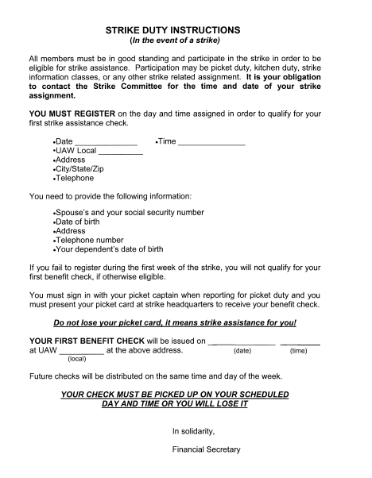

Slide 28
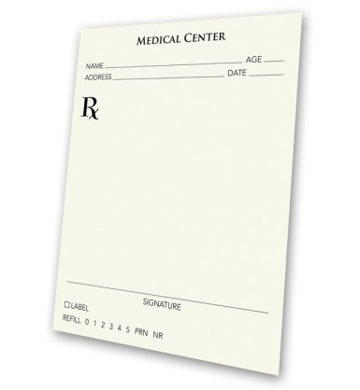
PREPARATION – Benefit Plan/s
Obtain Copies Of:
Medical Plans
Prescription Plan or Description
Schedule of Benefits
Life Insurance Plans
  With Level of Coverage

Slide 29

WHEN
THE
STRIKE
BEGINS

Slide 30
1. Notify the Strike Assistance Department that you are on strike.
2. Post or hand out the strike notice to all your striking members.
3. Set-up union hall for strike.
4. A date to register members will be arranged with the Strike Assistance
Dept.

Slide 31
WORKSITE PREPARATION
Look around your worksite for picket areas.
Safety: busy roads and intersections, parking.
How many members can picket safely?
Burning barrel locations?
“Port-a-John” locations?
Distance from local union and strike kitchen.

Slide 32
UAW Local 2008 Union Hall
Across the street from the worksite
Large parking lot
Large hall
ABC MFG
East Road
Parking
South Road
South Road

Slide 33
ABC MFG ~ PLANT LAYOUT
Shipping
Dock
GATE 3
DRIVEWAY
ABC MFG
East Road
South Parking Lot
GATE 1
GATE 2
South Road
South Road

Slide 34
September 20XX
Sunday | Monday | Tuesday | Wednesday | Thursday | Friday | Saturday
 |  |  |  |  |  | 1
2 | 3 | 4 | 5 | 6 | 7 | 8
9 | 10 | 11 | 12 | 13 | 14 | 15 Day 1
16 | 17 | 18 | 19 | 20 | 21 | 22 Day 8
23 /30 |  | 25 | 26 | 27 | 28 | 29 Day 15
Schedule Picket Assignments
Prepare “Strike Duty Instructions” Handout
Set up accounts for strike kitchen and supplies
Post Picket Assignments
Midnight
Contract
Termination
ON STRIKE
Assemble Picket Signs
12 Midnight
Picketing
Begins
Handout “Strike Duty Instructions”
Registration
A-F ~9 –noon
G-L ~1-4pm
Registration
M-R ~9 –noon
S-Z ~1-4pm
Set up hall for
registration
Enrollment forms sent
overnight to AmeraPlan
Eligible
for benefits
Members must bring in COBRA papers
Assistance
made
available

Slide 35
PICKET SCHEDULE ~ SUNDAY – SATURDAY
( 24 Hours / 7 Days / 6 Hour Shits )
BEGIN END
SHIFT 1 ~ MIDNIGHT 6:00 AM
SHIFT 2 ~ 6:00 AM NOON
SHIFT 3 ~ NOON 6:00 PM
SHIFT 4 ~ 6:00 PM MIDNIGHT

Slide 36
PICKET CAPTAINS
7 DAYS X 4 SHIFTS = 28 SHIFTS X 2 CAPTS = 56 PICKET CAPT’S
SHIFT | SUN | MON | TUE | WED | THR | FRI | SAT
1 | S. PRADER K. WALK | B. MIXON T. MOHR | B. WEST R. ROE | D WILSON G. WILSON | S. SCOTT F. TAYLOR | V. QUIROZ T. SHRUM | P. MASICH N. MATHEWS
2 | J. PENCE R. VIOLA | E. LOCKE P. MALLOW | J. TATE G. TATE | R. WOOD L. SIMS | M. POLDER M. STEGAR | A MERCKER J. O’BRIEN | K. OTTO B. PACE
3 | R. LORD B. YOUNG | R. MEADE R SMETANA | L. WEBB S VIGIL | V. PROBY E. MAY | R. LOVE D. MEO | R MAYER B. MIXON | S. RUTLEDGE S. SANDERS
4 | W. MELTON O. TORRES | B. REDD J. ZENT | G . STYLER C. WHITE | H. TINNIN J. SHIELDS | E. MCGEE A. REAVES | C. PETTUS P. SANTOS | G. SOULIA D SPARKS

Slide 37
PICKET ASSIGNMENTS
25 Members Per Shift
Shipping
Dock
GATE 3
10 Pickets
4 Shifts
100 Members
Picketing a Day
DRIVEWAY
ABC MFG
5 Pickets
East Road
700 Members
Picketing a Week
South Parking Lot
GATE 1
GATE 2
5 Pickets
5 Pickets
South Road

Slide 38
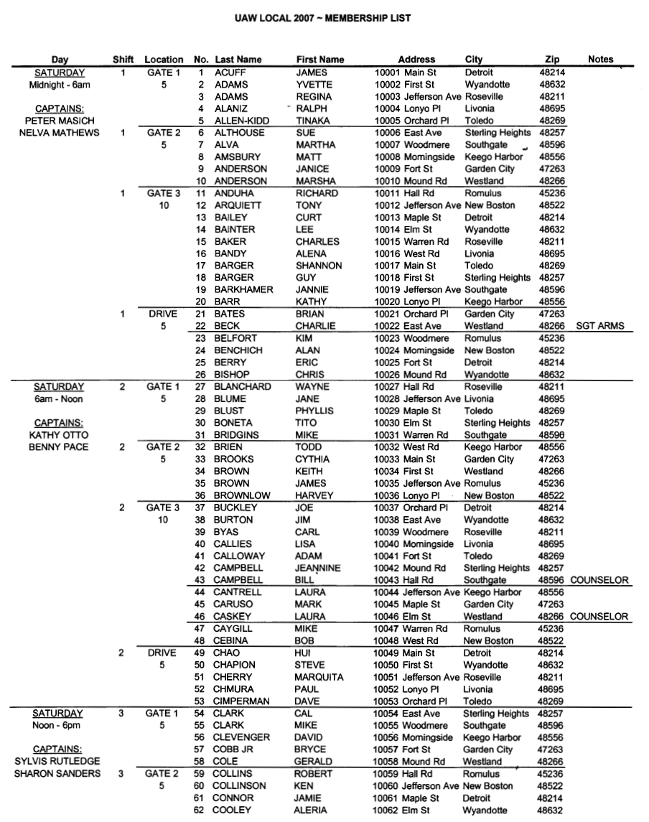

SCHEDULE PICKET ASSIGMENTS

Slide 39
STRIKE
DUTY
HANDOUT

Slide 40
September 20XX
Sunday | Monday | Tuesday | Wednesday | Thursday | Friday | Saturday
 |  |  |  |  |  | 1
2 | 3 | 4 | 5 | 6 | 7 | 8
9 | 10 | 11 | 12 | 13 | 14 | 15 Day 1
16 | 17 | 18 | 19 | 20 | 21 | 22 Day 8
23 /30 |  | 25 | 26 | 27 | 28 | 29 Day 15
Post Picket Assignments
Midnight
Contract
Termination
ON STRIKE
Assemble Picket Signs
12 Midnight
Picketing
Begins
Handout “Strike Duty Instructions”
Registration
A-F : 9 – noon
G-L :1 - 4pm
Registration
M-R : 9 – noon
S-Z : 1 - 4pm
Set up hall for
registration
Enrollment forms sent
overnight to AmeraPlan
Eligible
for benefits
Members must bring in COBRA papers
Assistance
made
available

Slide 41
STRIKE SIGNS
International Representative
will order strike signs
100 Signs per box
Sticks are NOT provided

Slide 42
ON STRIKE!
PICKET ASSIGNMENTS AT START OF STRIKE

Slide 43
September 20XX
Sunday | Monday | Tuesday | Wednesday | Thursday | Friday | Saturday
 |  |  |  |  |  | 1
2 | 3 | 4 | 5 | 6 | 7 | 8
9 | 10 | 11 | 12 | 13 | 14 | 15 Day 1
16 | 17 | 18 | 19 | 20 | 21 | 22 Day 8
23 /30 |  | 25 | 26 | 27 | 28 | 29 Day 15
ON STRIKE
Registration
A-F : 9 – noon
G-L : 1 - 4pm
Registration
M-R : 9 – noon
S-Z :1 - 4pm
Set up hall for
registration
Enrollment forms sent
overnight to AmeraPlan
Eligible
for benefits
Members must bring in COBRA papers
Assistance
made
available

Slide 44
Strike Representative
Medical Assist & COBRA
Strike Kitchen
Offices
Chairs
Registration Desk
Enrollment & Check Distribution
Registration
Desk ~ Sign In
Sargent-At-Arms
Sargent-At-Arms
Enter
Exit

Slide 45
REGISTRATION FORM
(Handbook p.33)

Slide 46
REGISTRATION ~ IRS FORM W-9

Slide 47
October 20XX
Sunday | Monday | Tuesday | Wednesday | Thursday | Friday | Saturday
30 Sept | 1 Set up hall for first pay | 2 | 3 | 4 | 5 Ratification of Contract | 6
7 | 8 Return To Work | 9 | 10 | 11 | 12 | 13
14 | 15 | 16 | 17 | 18 | 19 | 20
21 | 22 | 23 | 24 | 25 | 26 | 27
28 | 29 | 30 | 31 | 1 Nov. | 2 | 3
First Pay
A-L : 9am - 4pm
First Pay
M-Z: 9am - 4pm
First pay = $200.00
Final Pay
TBA
Final Pay
TBA
Final pay = $200.00 + $200.00 = $400.00

Slide 48
REGISTRATION CARD (HANDBOOK p. 34)
REGISTRATION CARD
TO THE STRIKE COUNSELOR
PICKET CARD
TO THE MEMBER
D
DOE JOHN xxx-xx-9999
ANY STREET , ANY TOWN , MI 99999
9 9999 99 999-999-9999
Mon 8 am - 4pm
JOHN DOE 999-99-9999

Slide 49
REGISTRATION CARD (HANDBOOK p. 34)
PICKET CARD
TO THE MEMBER
REGISTRATION CARD
TO THE STRIKE COUNSELOR

Slide 50
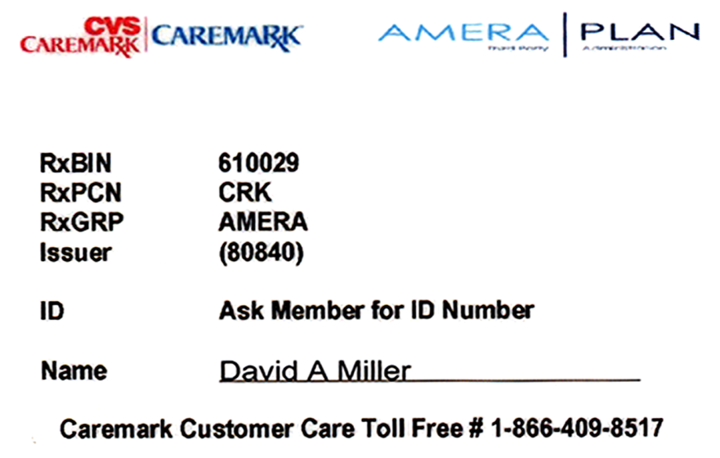
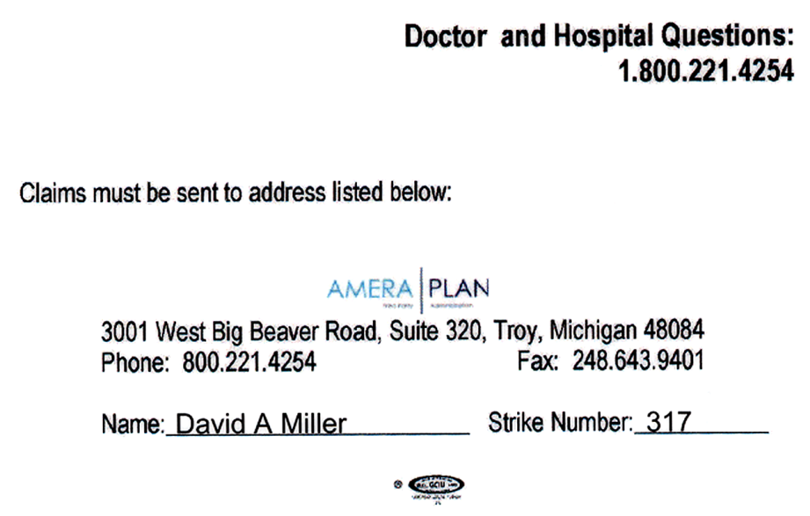
AMERAPLAN
MEDICAL AND RX CARDS
Doctor and Hospitals
(Front)
Pharmacy & Rx
(Back)

Slide 51
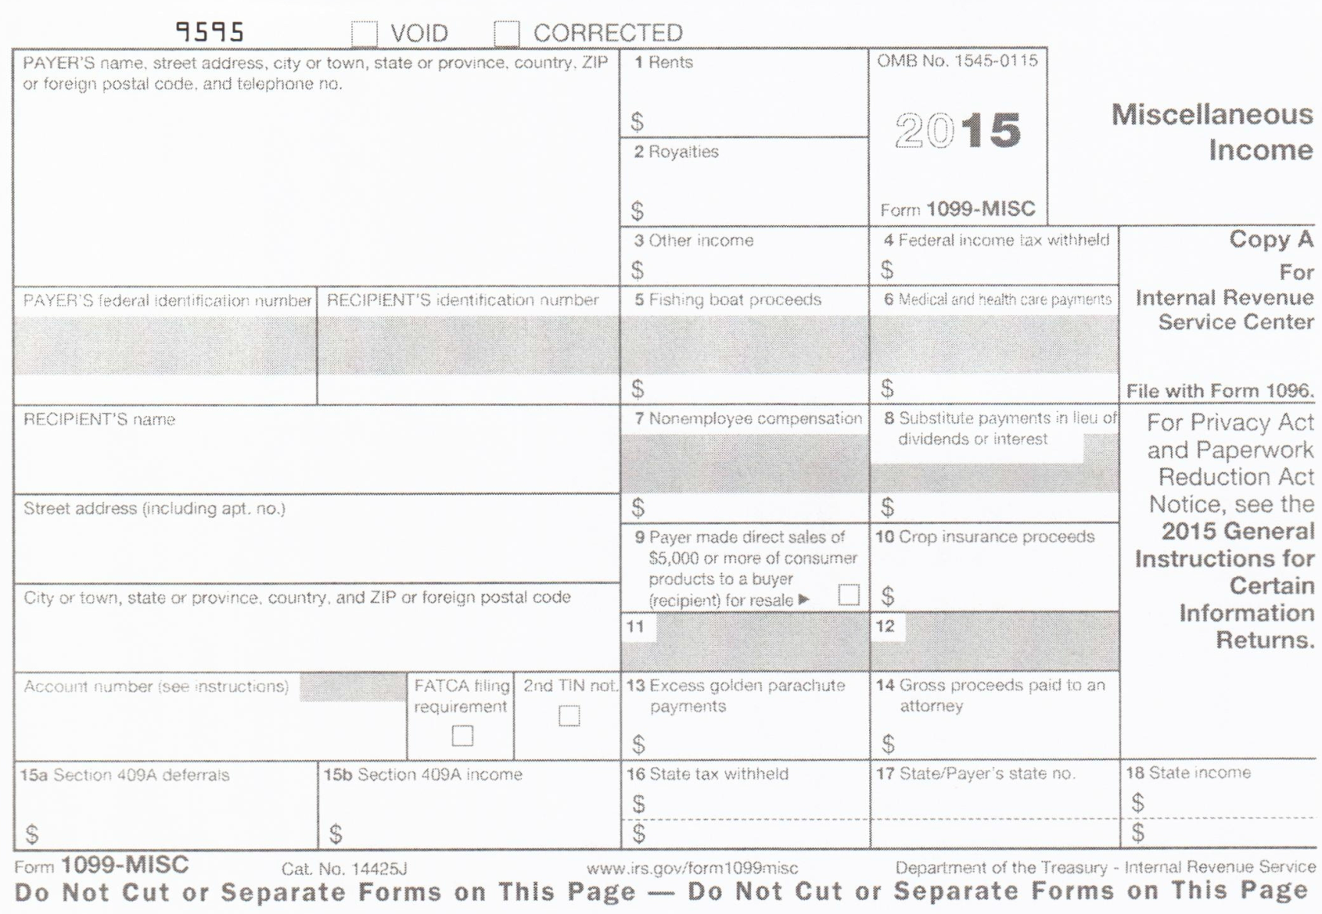
IRS FORM 1099-MISC

Slide 52

SAMPLE LETTER FOR MEMBERS
UAW LOCAL UNION 000
MAIN STREET
DETROIT, MI 48214
TO WHOM IT MAY CONCERN: PLEASE BE ADVISED THAT ____________________, SOCIAL SECURITY #____________ IS CURRENTLY INVOLVED IN A LABOR DISPUTE AND IS RECEIVING STRIKE BENEFITS OF $200.00 PER WEEK. YOUR COOPERATION IN THIS MATTER IS GREATLY APPRECIATED. SINCERELY, ____________________ ________________________ ___________________ CS CHAIRPERSON-LU000 FINANCIAL SECRETARY-LU000 PRESIDENT-LU000

Slide 53
SAMPLE LETTER TO CREDITORS
Date: Creditor Name/Address RE: Account Number Dear (Creditor Name): I am writing this letter to request a temporary change in the repayment terms of my account. Since I have become unemployed, I have had to make some financial adjustments. I do have some income from ________. However, when I carefully examined my financial situation and made a strict budget for my basic expenses, it also became necessary to ask each of my creditors to accept reduced payments. I would appreciate your cooperation in making this payment plan work. In place of my regular monthly payment of $_____due on the _____, I am requesting that you accept payments of $ _____ paid on the _____. I assure you that I will add no further debt until my financial situation improves. I will begin making normal payments again as soon as possible. I regret that I have to ask for this consideration and hope that you will understand. When there is a change in my situation, I will notify you immediately. Your understanding during this difficult time is most appreciated. __________________________ (Signature)

Slide 54
WHEN
THE
STRIKE
ENDS

Slide 55
END OF STRIKE
The Final back-to-work check will be distributed at the end of the strike.
Final reimbursements will be completed on the last Weekly Strike Analysis (A-60).
Members who received $600 or more in strike benefits will be mailed on the IRS 1099 Form. They are mailed in January, following the year benefits were paid.

Slide 56
Strike Exercise

Slide 57

Strike Assistance Department
313-926-5406

Slide 58

QUESTIONS

